Slide 1

Distance Education Update
SCCCD Board of Trustees
October 11, 2023
Omar Torres, James Glapa-Grossklag, Joy Shoemate

Slide 2

Agenda
What is Distance Education?
What does the data show?
How do we support students and faculty?
What’s new with Zero Textbook Cost classes?

Slide 3




Online Education Department
Joy Shoemate
Carol Johnston
Chloe McGinley
Helen Graves
Director, Online Education
Online Education Coordinator
Online Education Coordinator
Instructional Designer (PT)

Slide 4

What is Distance Education?

Slide 5


Distance Education and the College Mission
“College of the Canyons delivers an accessible, holistic education for students to earn associate degrees, certificates, and credentials, to prepare for transfer, and to attain workforce skills. The College champions diversity, equity, inclusion, and global responsibility, while providing clear pathways in an engaging, supportive
environment where all students can successfully
achieve their educational goals.” (Emphasis added)
Not bound by place and time

Slide 6

Distance Education Defined
AP 4105 (Distance Education) and Title V define DE as “…education that uses one or more technologies …to deliver instruction to students who are separated from the instructor and to support regular and substantive interactions between students and the instructor, either synchronously or asynchronously.”
Title V: “Distance Education does not include Correspondence Education.”

Slide 7
Description for Students
Question | Online | OnlineLIVE | HyFlex | Hybrid | InPerson
How will my class be conducted? | All class work is conducted online through Canvas without a requirement for real-time/live meetings. | You will meet with your instructor online during scheduled class times via Zoom and Canvas. | Instructors teach HyFlex classes on campus in a classroom, and will welcome students to join in person or via Zoom. You will have the choice to meet with your instructor on Zoom or in person during scheduled class times. | Hybrid classes combine the learning formats of online and on-campus classes. In a hybrid class, you can expect to have some on-campus meetings, as well as complete coursework independently online. | Instructors teach InPerson classes on campus in a classroom. You will meet with your instructor in person during scheduled class times at the classroom location listed in the class schedule.
What will a combination of these formats look like? | Online & OnlineLIVE: Some class meetings will be conducted via Zoom during scheduled times. The remainder of the class will be Online in Canvas. OnlineLIVE & InPerson: Some class meetings will be conducted via Zoom, and some class meetings will be conducted in person during scheduled times. Please refer to the schedule of classes for meeting dates, times, and locations.
Notes:
https://www.canyons.edu/academics/onlineeducation/studentsupport/courseformats.php

Slide 8
Distance Education: Historic Trends
Growth in OL Sections
FA06: 100% online sections = 3% of all sections
FA19: 100% online sections = 18% of all sections
FA22: 100% online sections = 33% of all sections
Notes:
*F20 increase is due to stay at COVID-19 stay at home orders, includes only courses designated at 100% online in section type (ONLINE) of 320 file
Includes credit and non-credit

Slide 9
DE sections = 54% of all FA 22 sections
Notes:
All modalities plus face to face with graphic showing total % of DE courses

Slide 10
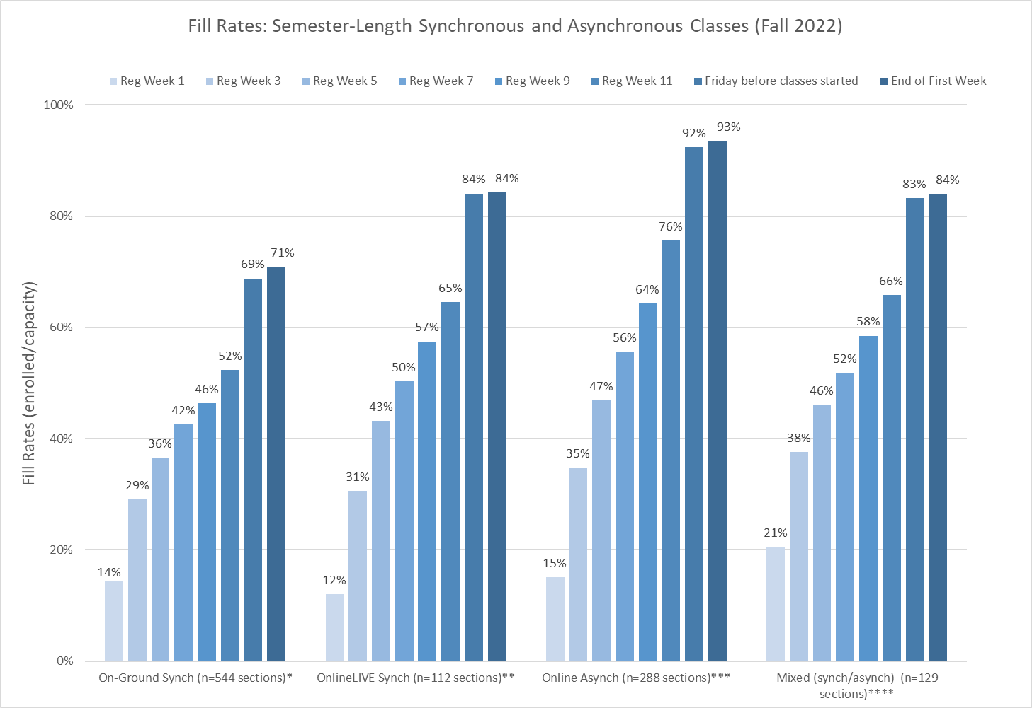
Notes:
*On-Ground Synch (classes offered at CCC or VLC or SCL or Sectype=Hyflex). Section count as of Friday before classes started. Note - 11 sections were Hyflex.
**OnlineLIVE=Synchronous Online (Secloc=OLCLV). Section count as of Friday before classes started.
***Online Asynch=100% online (Secloc=OLC). Section count as of Friday before classes started.
****Mixed Modality (Secloc=OLMIM or OLSIM) or Sectype=Hybrid. Section count as of Friday before classes started.
Other Methodology Notes:
1-Excludes Short-Term, ISAs, CWE, Nursing, Noncredit, Rising Scholars (classes at PDC and CRDF), Classes offered at high schools, positive attendance credit sections and sections with cap less than 10 or cap greater than 99.
2-All sections included are credit, weekly (census=W, IW and IWL)
3-On-ground synchronous sections account for 51% of the offerings, followed by Online asynchronous, Mixed modality (online/OnlineLIVE or Online/On-ground) and Online Synchronous (OnlineLIVE).

Slide 11
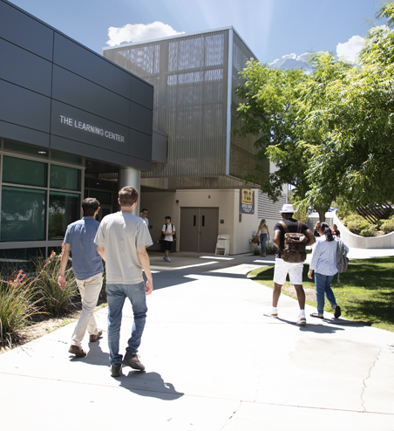
What does the data show?

Slide 12
Notes:
Statewide DE success rate - credit courses 68.04% (FA22)
https://datamart.cccco.edu/Outcomes/Course_Ret_Success.aspx
Online 2022 N=15,175
African American - 817
Asian/Filipino – 1,448
Latinx – 8,025
Two or more - 764
White – 4,121
OnlineLIVE N=3,309
African American - 154
Asian/Filipino - 452
Latinx – 1,709
Two or more - 155
White - 839

Slide 13
Notes:
Statewide DE retention rate = 86.08% (FA22)
Online 2022 N=15,175
African American - 817
Asian/Filipino – 1,448
Latinx – 8,025
Two or more - 764
White – 4,121
OnlineLIVE N=3,309
African American - 154
Asian/Filipino - 452
Latinx – 1,709
Two or more - 155
White - 839

Slide 14
Notes:
In the past we've showed overall data, now based on great work available thanks to Daylene/IRPIE, we're highlighting the data we can go deeper into such as divisions
2022 N=
African American/Black =59
Asian/Filipino =74
Latinx =767
Two or more races =48
White =346
FA22 statewide success rate 62.09%

Slide 15
Notes:
FA 22 statewide retention rate = 83.4%

Slide 16
Notes:
FA22 statewide success rate 62.09%
2022 N=
African American/Black =171
Asian/Filipino =370
Latinx =2111
Two or more races =214
White =1122

Slide 17
Notes:
FA 22 statewide retention rate = 83.4%

Slide 18

How do we support students and faculty?

Slide 19
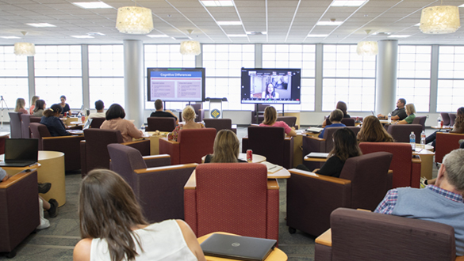

Faculty Support
DE Teaching Certifications
22/23 New Certifications Earned
55 Canvas Certifications
64 Online/Hybrid Certifications
92 OnlineLIVE Certifications
19 HyFlex Certifications
141 Refresh Online Hybrid Certification
4 Certification Types
Canvas
Online/Hybrid
OnlineLIVE
HyFlex
Online Instructor Retreat
Notes:
Aug 22 – July 23
Culturally responsive pedagogy and DEI resources
Humanizing to overcome social distance

Slide 20





2023: Faculty Resources
Culturally
Responsive
Pedagogy
Accessibility & OER Training
DEI & OER Resources
Humanizing Online Teaching
Resources for equity-minded and culturally relevant teaching practices
Week-long facilitated online courses with instructional designers
Openly licensed resource repositories , equity rubrics, and diverse image libraries
Developing week-long online courses for faculty on humanizing online teaching

Slide 21
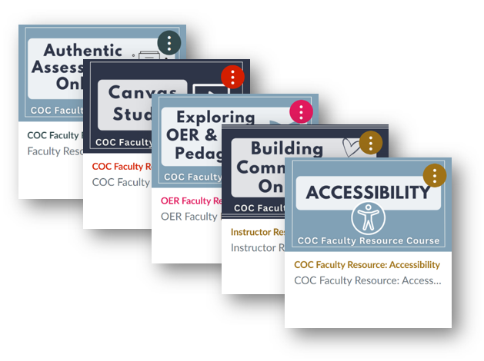

2023: Faculty Resources
Canvas Course Templates
Online Self-paced Courses
Ready-to-use content incorporating best practices in instructional design and accessibility
Self-paced learning modules created to fit the needs of COC faculty
Notes:
New courses in 2023: Exploring OER & Open Pedagogy, Authentic Assessments Online, Spicing Up Canvas
Coming this year: non-credit templates

Slide 22

Student Support Resources
Online Readiness Self-Assessment
Orientation Letters
Student Emails
Phone & Zoom Support
Notes:
Explaining course formats & other support questions

Slide 23

CVC Course Exchange
COC is now a Teaching College in the CVC Exchange
Students from other CCCs can enroll in our Online and OnlineLIVE courses
Students register in the Exchange after all COC priority student registration dates have passed
Students (and faculty) can access FAQs on Online Ed’s website

Slide 24

What’s new with Zero Textbook Cost classes?

Slide 25

ZTC Defined
Zero Textbook Cost (ZTC) courses utilize Open Educational Resources (OER) to provide free digital textbooks to students

Slide 26
Notes:
Comparing all ZTC to non-ZTC
*This is not comparing like classes

Slide 28
Notes:
Taking a ztc class has a positive impact for most special populations
Change in percentage growth

Slide 30

2021: COC was instrumental in securing $115M state funding for a revived grant program
2023: COC is the Technical Assistance Provider for the $115M grant
2023: Locally, COC secured $400,000 for Land Surveying and Sustainable Architecture ZTC pathways
What’s Next for ZTC?
Notes:
Existing ZTC pathways: SOCI, Water, ECE, Psych, Couns, Arch

Slide 31
Thank you!
❤
Chancellor Van Hook
Vice President Torres
Vice President Temple
Vice President Ruys
Associate Vice President Wickline
Associate Vice President Meuschke
Academic Senate President Andrus

