Slide 1
Math Consortium
October 10, 2017

Slide 2
CAASPP
California Assessment of Student Performance and Progress
2017 Results

Slide 3

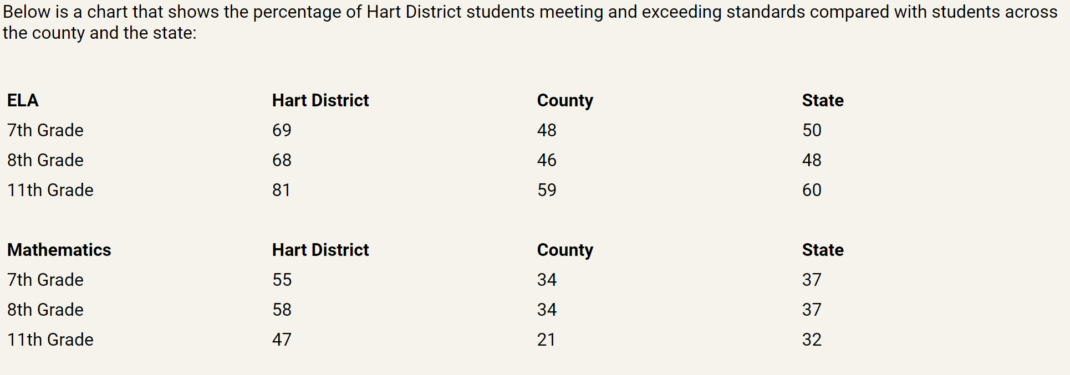

Slide 4
In anticipation of the accountability that will be tied to how well high school juniors perform on the English and mathematics CAASPP assessments, the Hart District board increased the math requirement for graduation from 20 to 30 credits. This requirement, that begins with the class of 2019, this year’s junior class, will ensure that all students are in math classes until they take the CAASPP.
Next spring’s administration will be the first CAASPP administration where all Hart District students taking the assessments are still enrolled in math classes, and growth in student performance in mathematics is anticipated.

Slide 5
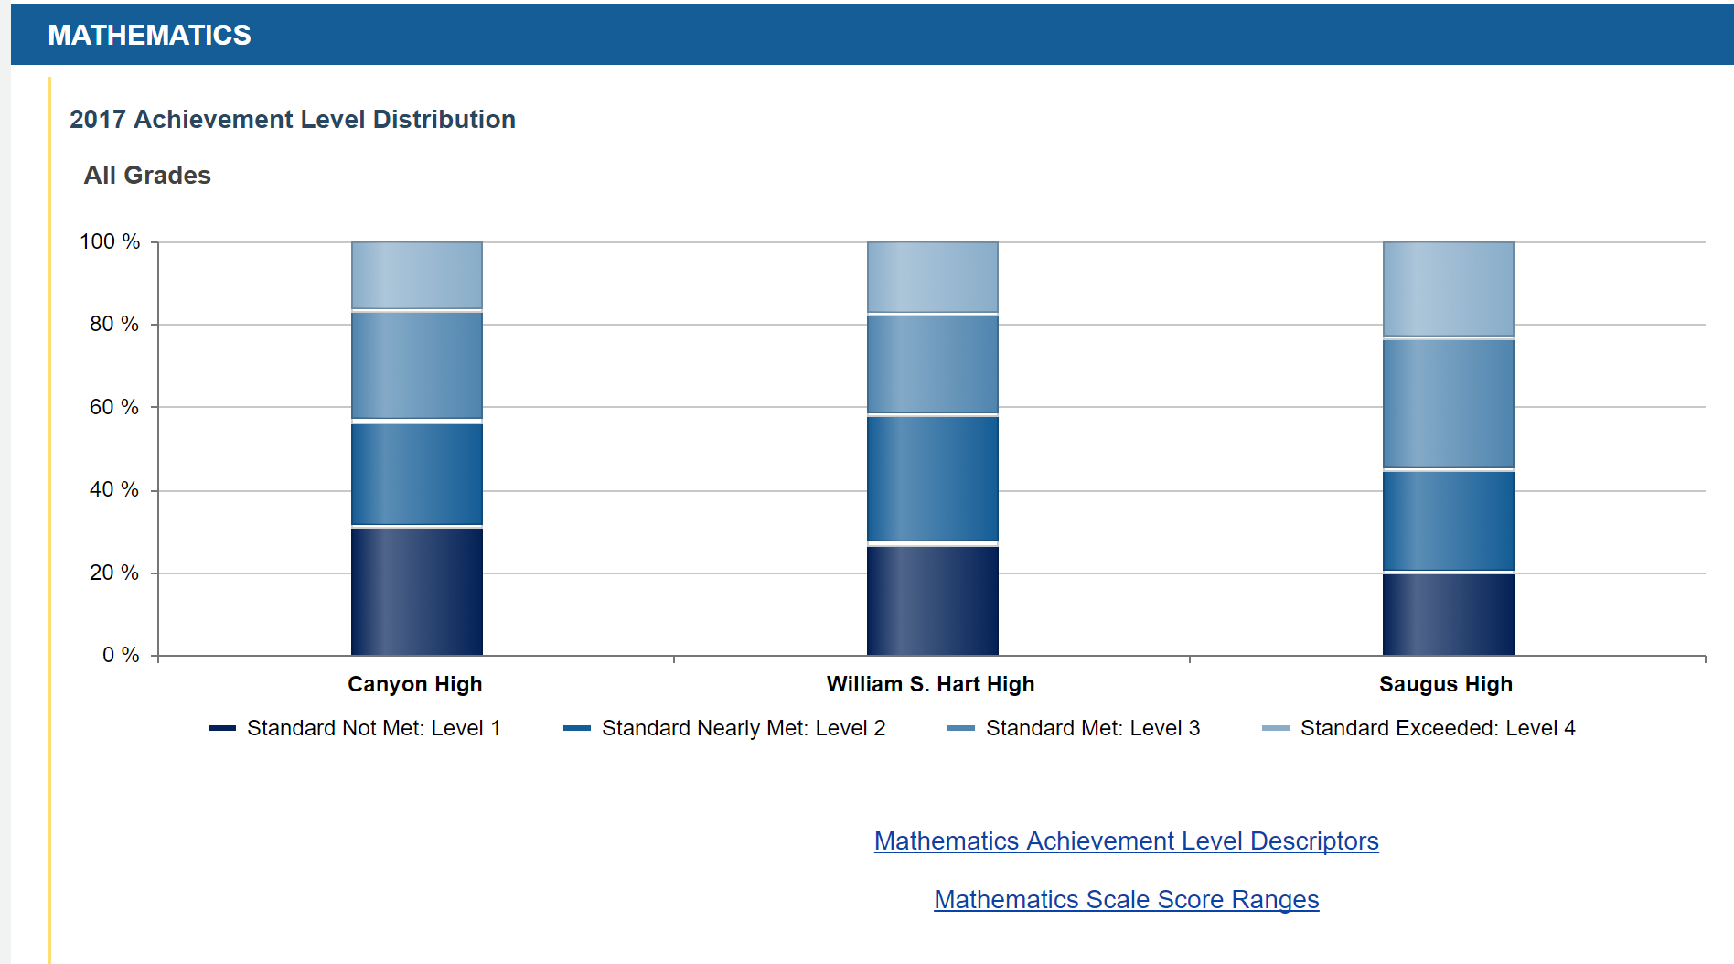

Slide 6
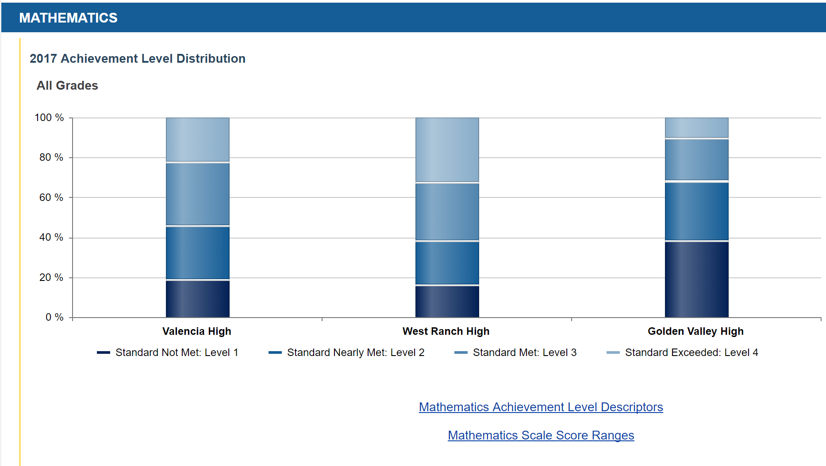

Slide 7
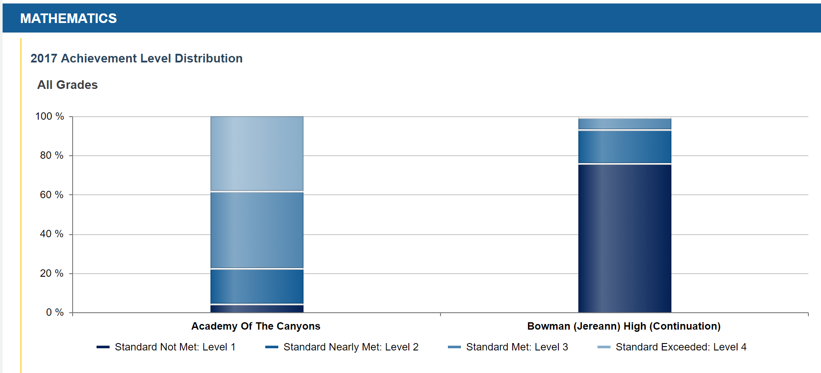

Slide 8
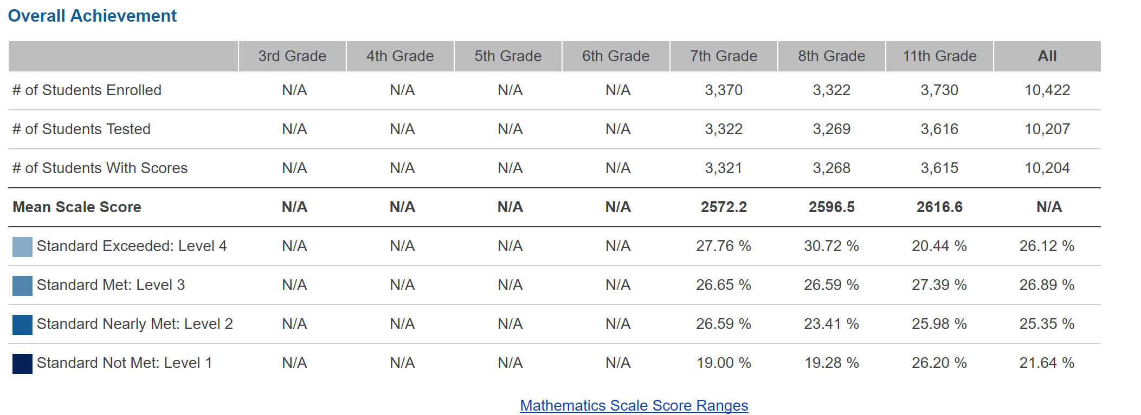
2017 Hart District Overall (Math CAASPP)

Slide 9
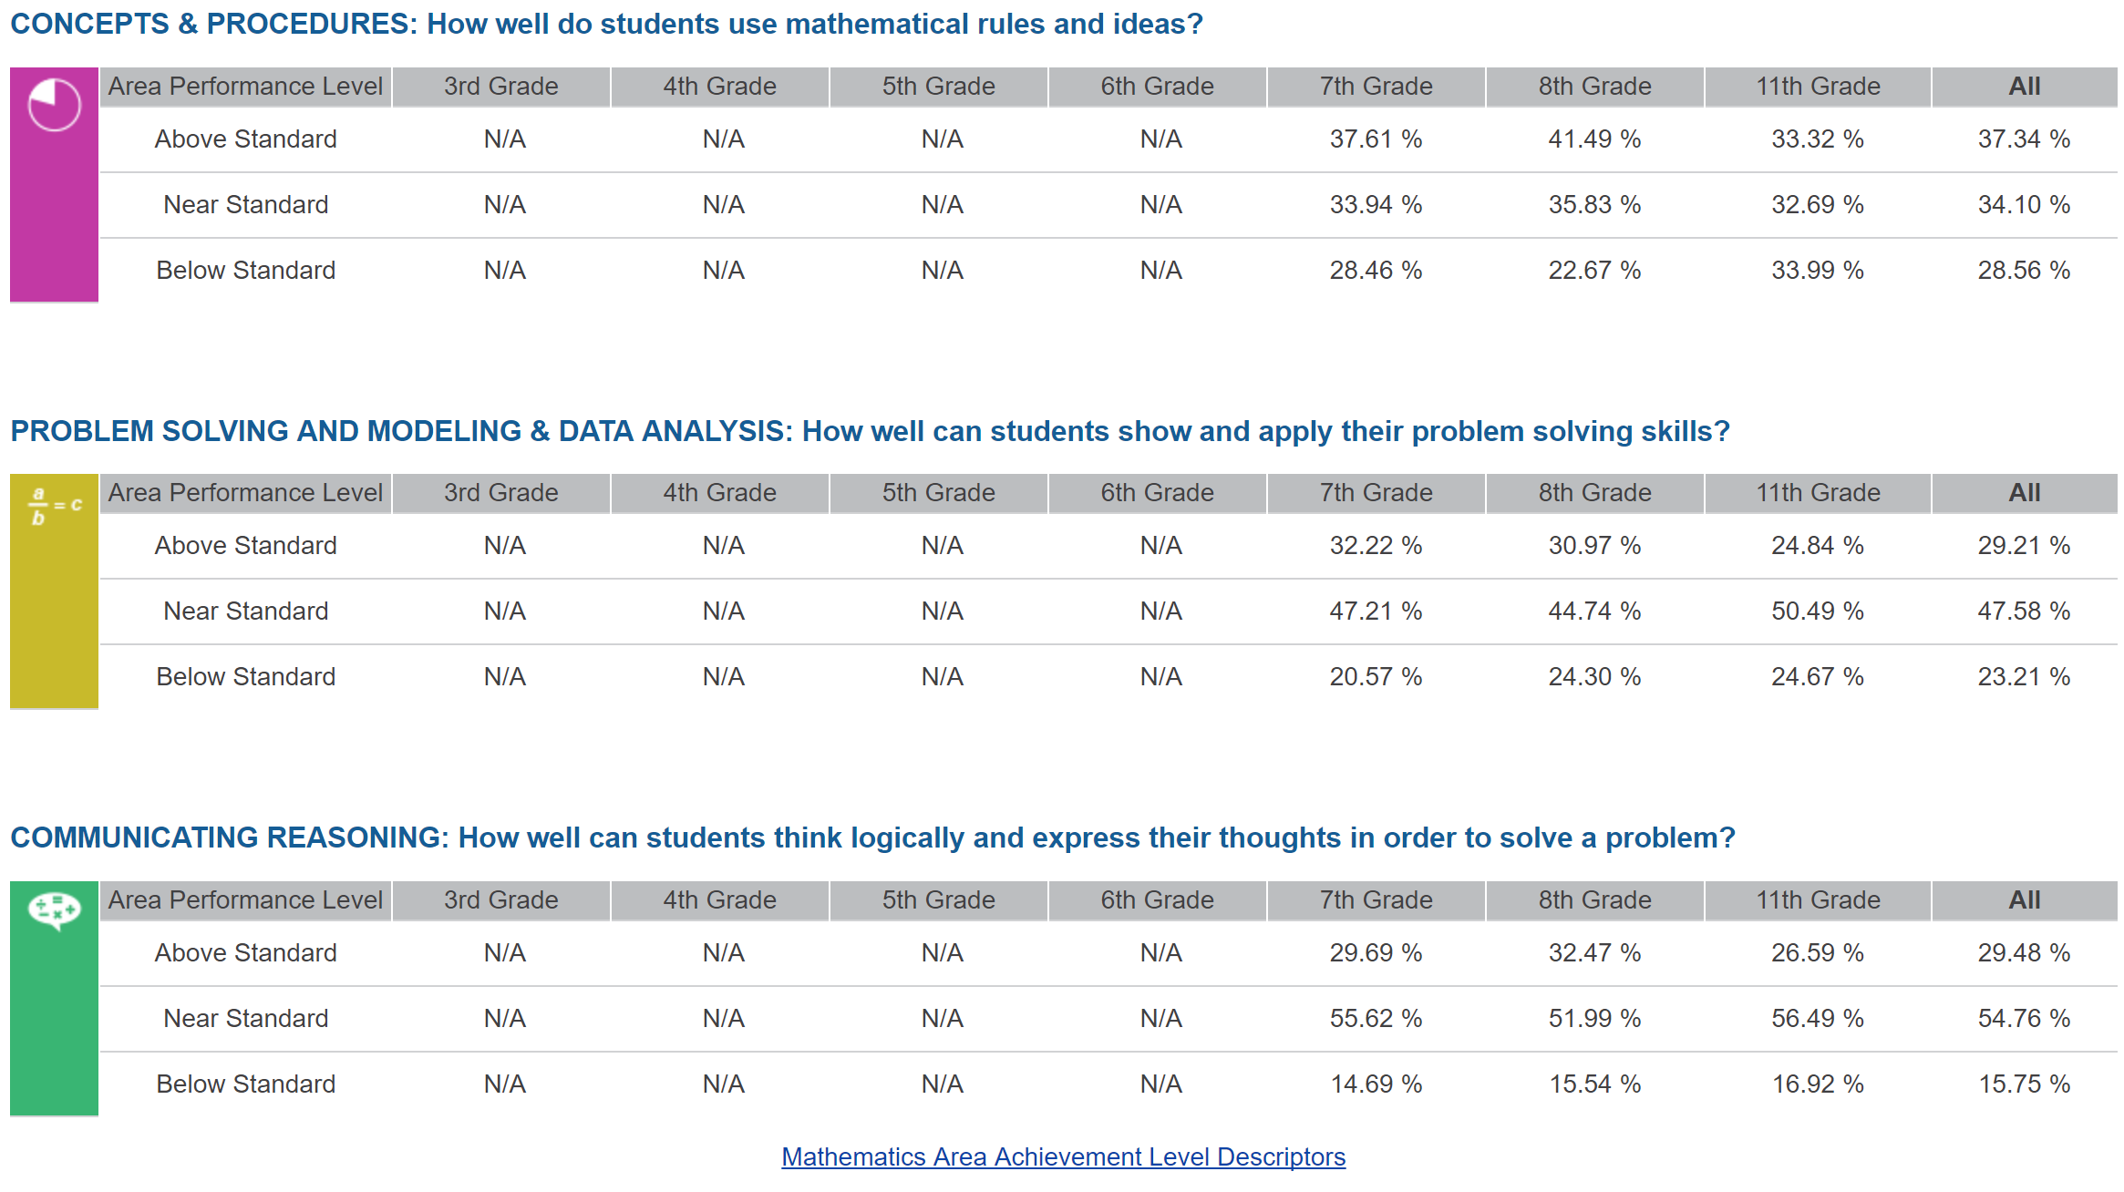
2017 Hart District Overall (Math CAASPP)

Slide 10
Remaining Slides Are From 2016
September Consortium Meeting
For Comparison

Slide 11
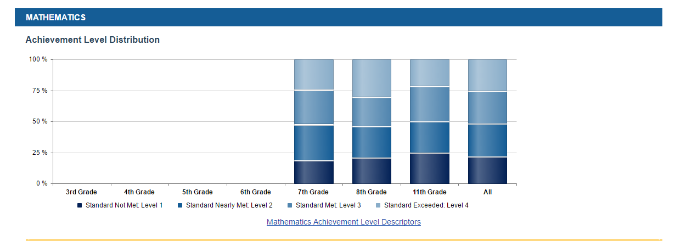
CAASPP 2016 - Math

Slide 12
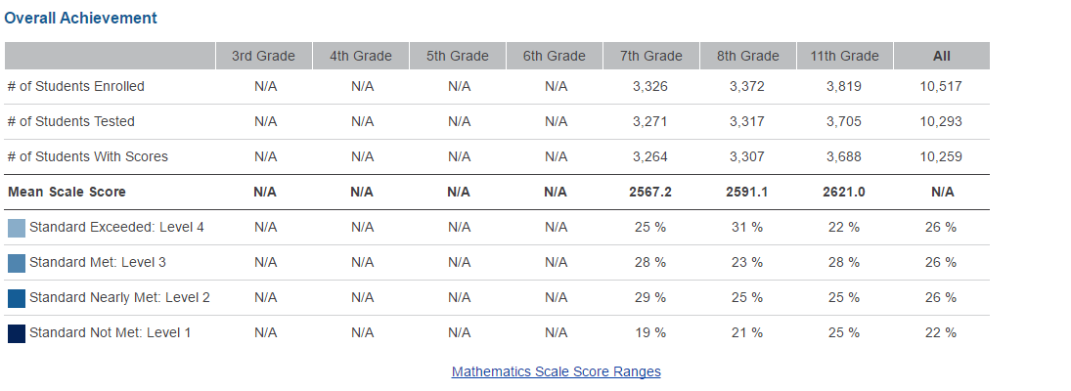
CAASPP 2016 Math Overall Results

Slide 13
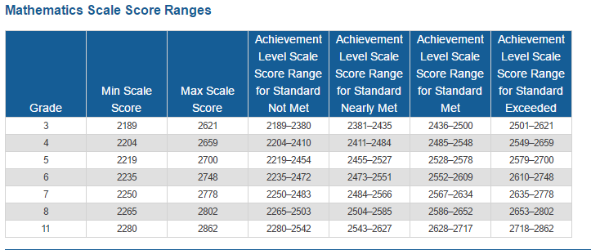

Slide 14
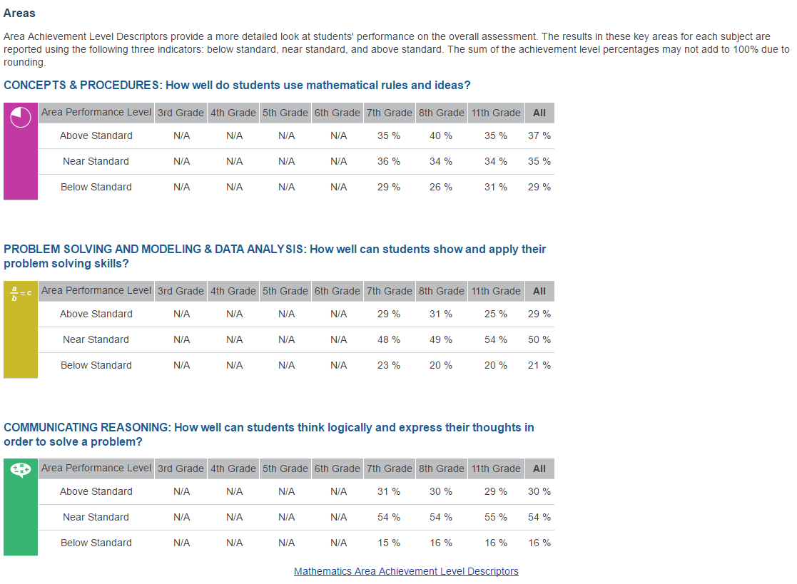

Slide 15
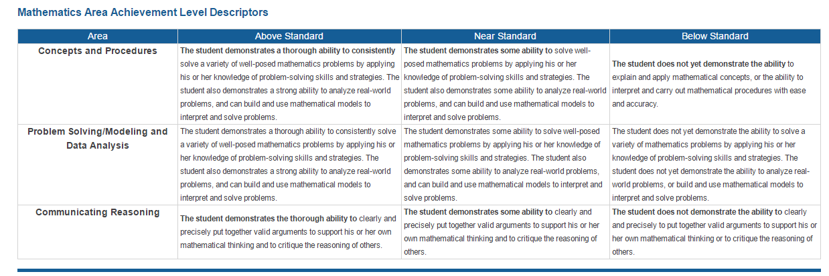

Slide 16
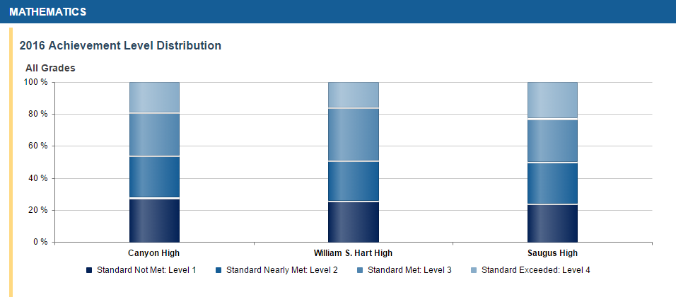

Slide 17
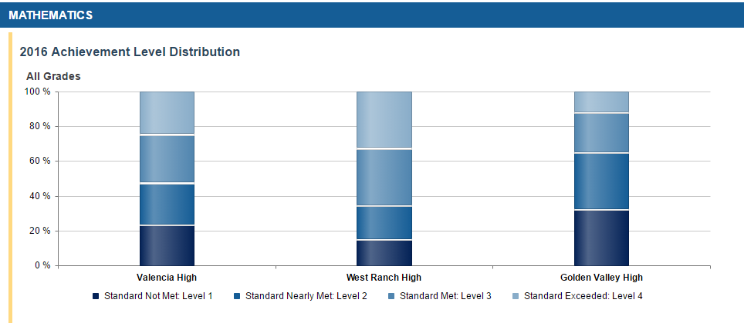

Slide 18
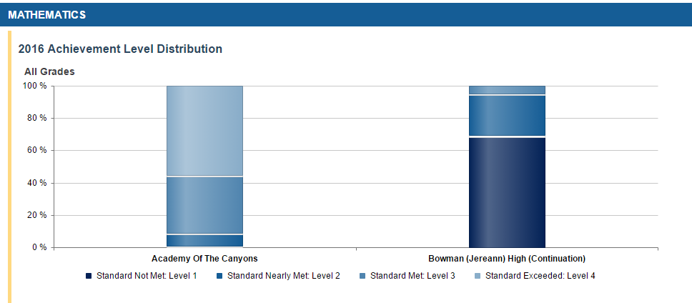

Slide 19
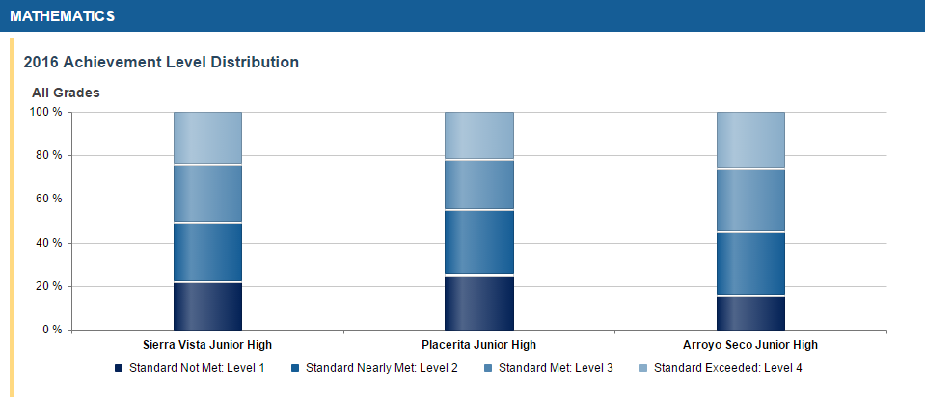

Slide 20
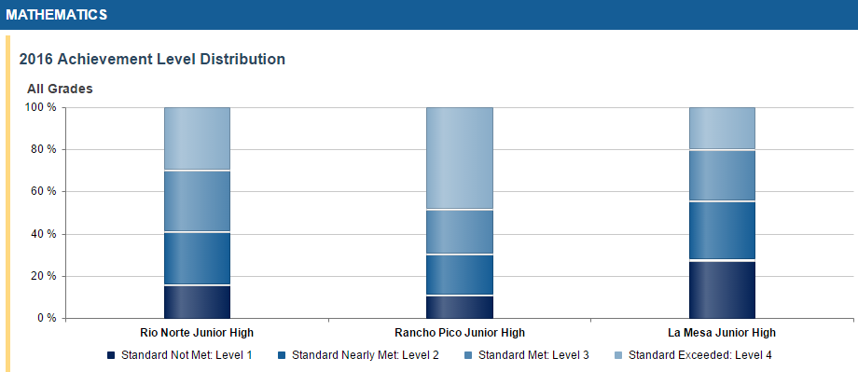

Slide 21
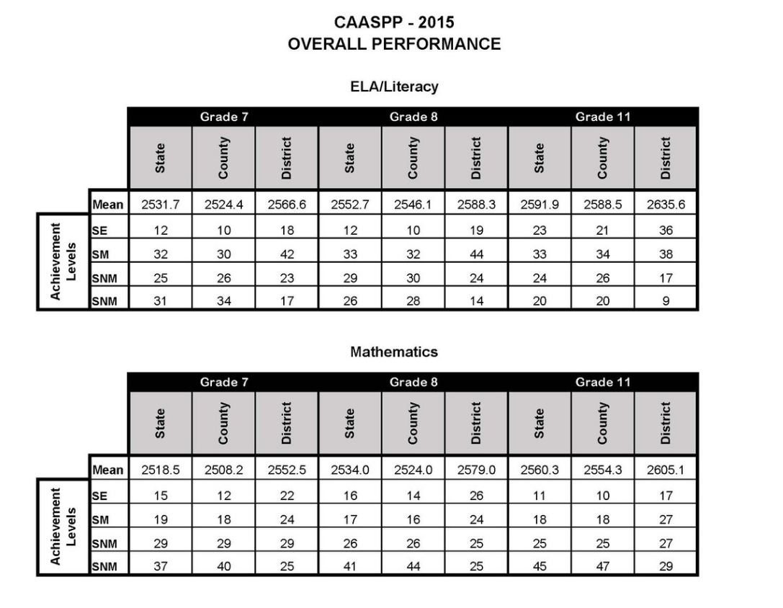

Slide 22
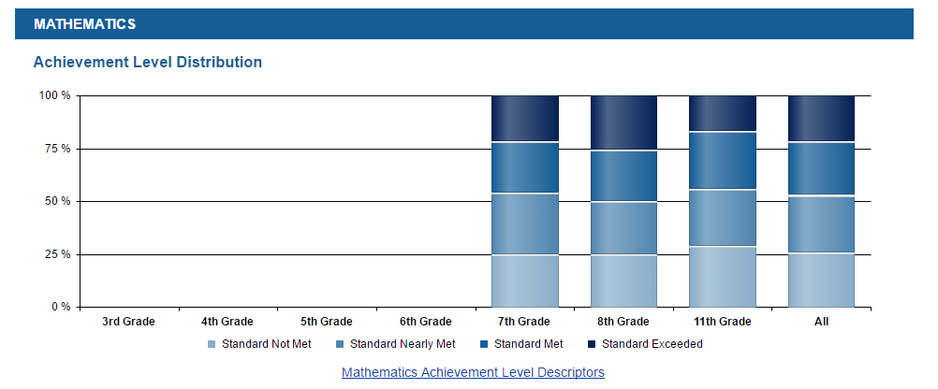
CAASPP 2015 - Math

Slide 23
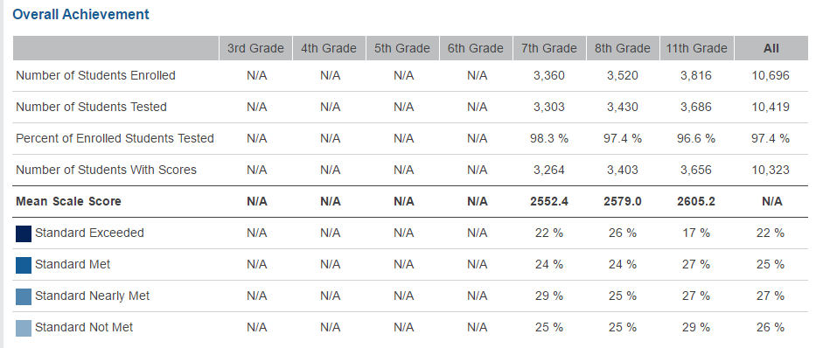

Slide 24
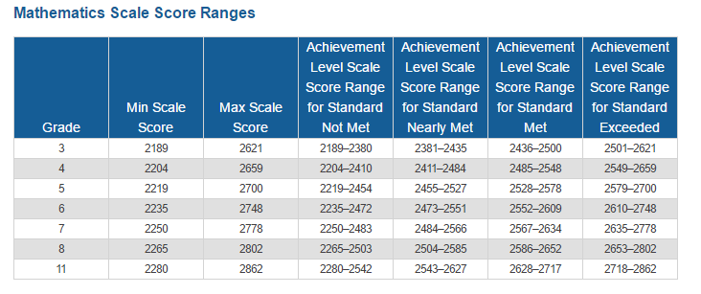

Slide 25
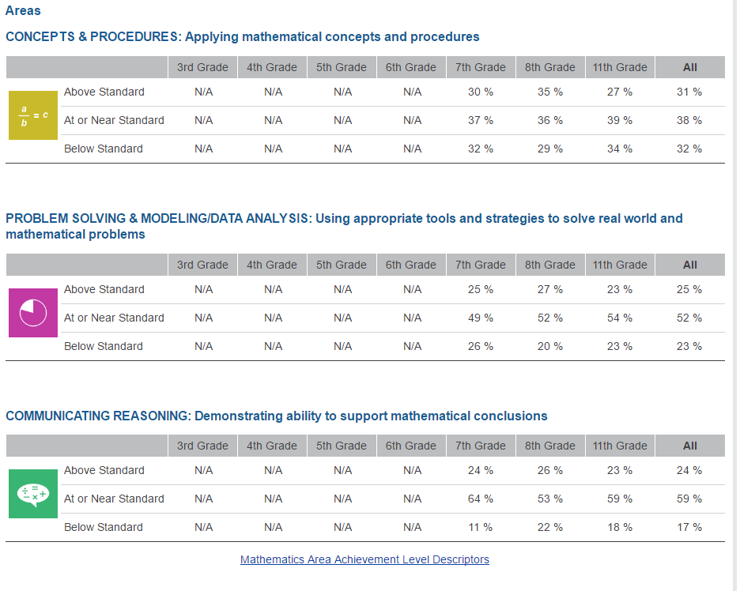

Slide 26
