Slide 1
AB 705 and Its Implementation Plans in Mathematics
Mathematics Department
College of the Canyons
Notes:
Nakia

Slide 2
What is AB (Assembly Bill) 705?
AB 705 is a STATE LAW unanimously passed in the Assembly and the State Senate in September of 2017 and signed into law on October 13, 2017. It went into effect as of January 1, 2018.
More specific guidelines were published on July 11, 2018.
See https://asccc.org/ab-705-resources for more details and resources.
Notes:
Serena

Slide 3
AB 705 Requirements
Under AB 705, colleges are
  To use multiple measures to place students into math, English, and ESL.
  To maximize the probability that students complete math and English (transfer-level) within a 1-yr timeframe.
  NOT allowed* to place students into pre-transfer-level math or English unless
  “highly unlikely to succeed” AND
  enrollment in the pre-transfer level helps the student to complete math/English within a year
  *(below-transfer level course that lengthens the time it takes the student to complete math or English)

Slide 4
Why AB 705?
To increase the number of students who enter and complete transfer-level English and mathematics in one year. THIS IS THE BIG BARRIER FOR GRADUATION/TRANSFER NOW.
To minimize equity gap created through inaccurate placement processes.
To increase the number of students completing transfer-level English as a Second Language within three years.
(Many other states are doing something similar.)
Notes:
LaTonya

Slide 5
Double, Double Toil and Trouble
By fall 2019, AB 705 in math must be fully implemented: placement, curricular design, co-curricular design, and non-curricular support.
The only “approved” statewide placement test, ACCUPLACER, is going away at the end of 2018.
We will address both of these with several major changes.
Notes:
Serena

Slide 6
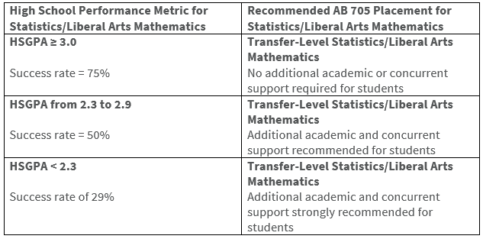
“Default Placement Rules” – Math (SLAM – Statistics, Liberal Arts Math)
Notes:
Serena

Slide 7
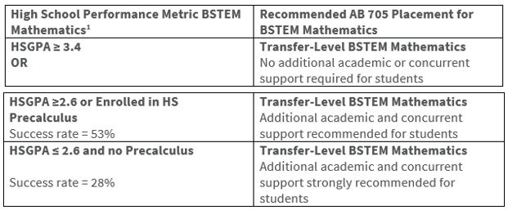
“Default Placement Rules” – Math (BSTEM – Business, STEM)
Notes:
Serena

Slide 8
What Can Colleges Be Doing for AB 705-Compliance? (114 comm colleges) Part 1
Creating new courses
  “enhanced” transfer-level courses (remediation included)
  co-requisite courses for remediation: credit courses (1 or 2 units) or non-credit courses (no fees)
  a quantitative reasoning course for liberal arts majors
  new courses combining/revising many developmental courses
  Developing one-year (two-semester) courses
Notes:
Dustin

Slide 9
What Can Colleges Be Doing for AB 705-Compliance? (114 comm colleges) Part 2
Re-designing their placement process (emphasis on H.S. GPA and course work, not an assessment test)
Eliminating all developmental courses (like CSU)
Offering summer “bridge” courses for catch-up (like CSU)
Having in-class embedded tutors
Increasing access to learning centers (TLC)
Professional development for better pedagogy
Having more supplemental instruction (workshops, etc.)
Notes:
Dustin

Slide 10
What Are We Doing as the Math Department at College of the Canyons?
No more “assessment test” (after Dec. 2018)
  Placement by H.S. GPA, last math course passed, & the grade in that course
  Self-reported (could be checked)
Everyone will be placed in a transfer-level course (with or without a “co-requisite”)
A new course “Liberal Arts Math” (Math 100)
Considering non-credit “modularized” courses for extra support
Notes:
Dustin

Slide 11
What Are the “Co-Requisite” courses?
Concurrent support courses
  Math 092 for Trigonometry (Math 102)
  Math 093 for College Algebra (Math 103)
  Math 090 for Statistics (Math 140)
They meet for 3 lab hours each week.
The “cohort” (vs. mingling) model with the same instructor
They provide just-in-time remediation (arithmetic, algebra help, geometry review for 102, etc.)
Notes:
Dustin

Slide 12
What Math Courses Will Students Take Then?
Liberal Arts (Non-STEM)
  Liberal Arts Math (100) or
  Statistics (140) (maybe with support 090)
Business
  College Algebra (103) (maybe with support 093)
  Business Calculus, Finite Math, etc.
STEM
  Trigonometry (102) (maybe with support 092)
  Pre-Calculus, Calculus I, II, III, etc.
Notes:
Dustin

Slide 13
What about Developmental Math?
Pre-Algebra (058), Elementary Algebra (060), Pre-Statistics (075), and Intermediate Algebra (070) will continue to be offered (for now).
No one will be placed into these (AB 705).

Slide 14
What is Liberal Arts Math (Math 100)?
New 3-unit math course (pending transfer agreement with CSU and UC schools)
Designed to be the only math course required at college level for non-STEM students.
Contents:
  Logic, sets, arguments, problem-solving, fallacies
  Finance: savings, loans, mortgages, federal deficits
  Probability and statistics
  Exponential growth and decay
  Math in the arts
  Math in politics
  Crowning achievements in mathematics

Slide 15
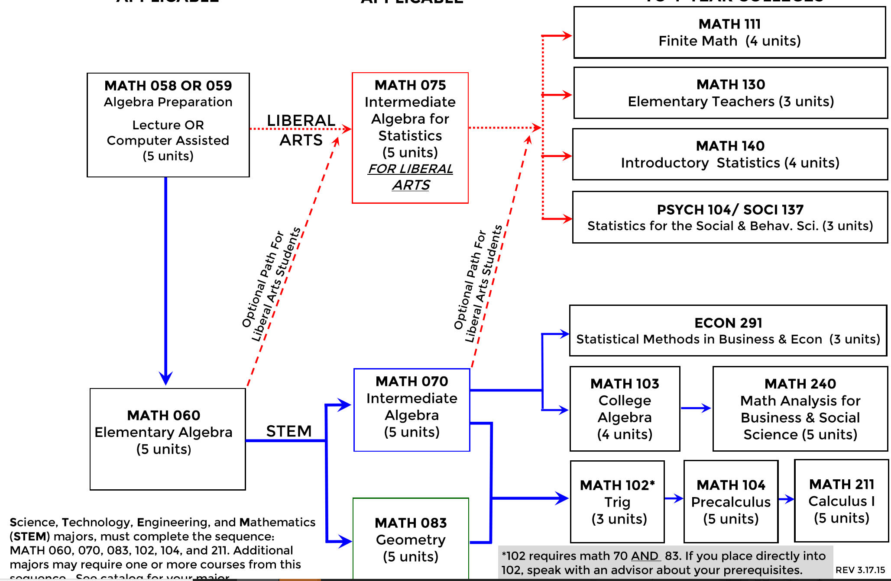
Current Course Sequence

Slide 16
New Course Sequence (Fall 2019)
{
Liberal Arts Math
Non-STEM
Statistics*
College Algebra*
Business Calculus
Business, etc.
Trigonometry*
Pre-Calculus
Calculus I, II, and III
STEM
* These courses have co-requisite support courses for some students.

Slide 17

Questions?

